Slide 1
THE FUNDAMENTAL THEOREM OF CALCULUS.
There are TWO different types of CALCULUS.
1. DIFFERENTIATION: finding gradients of curves.
2. INTEGRATION: finding areas under curves.
These concepts seem to be totally different, but there is a connection!

Slide 2
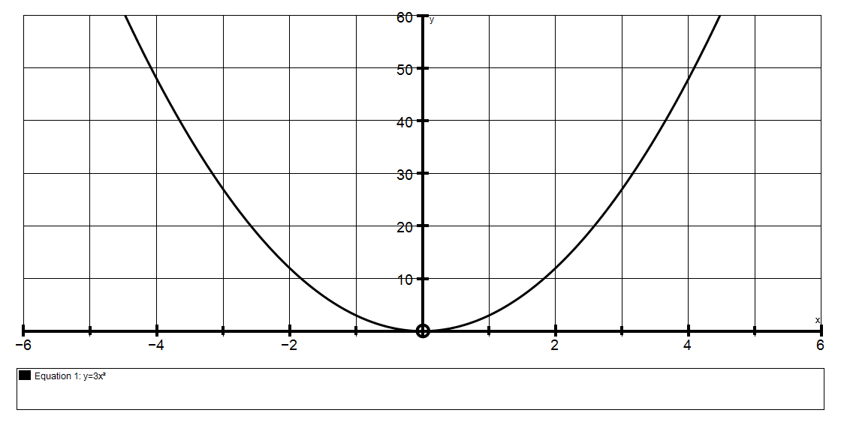
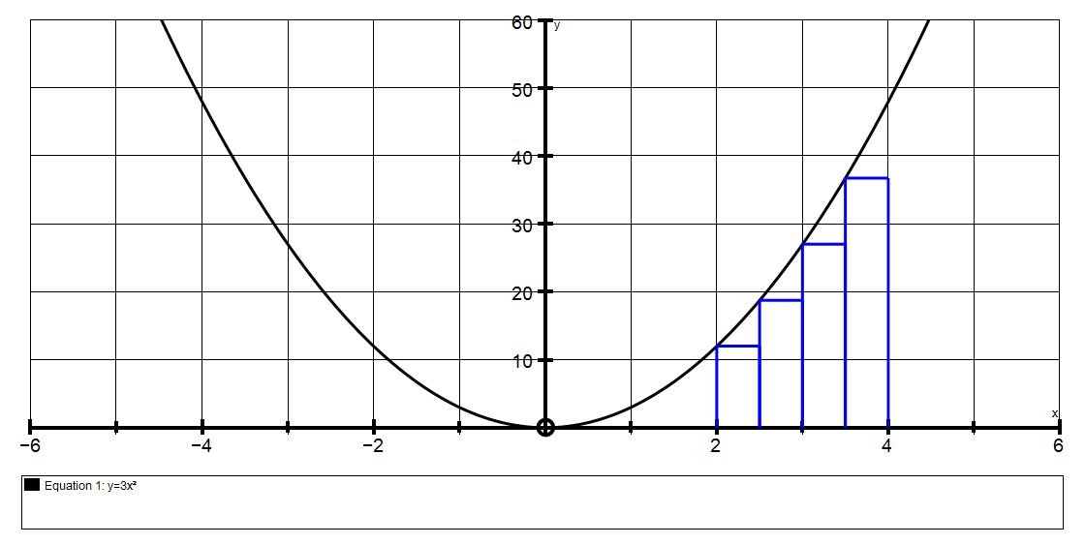
To estimate area A
under y = 3x² from A
x = 2 to x = 4
we could split it into small rectangles:
With 4 rectangles,
the area ≈ 48.96 units²

Slide 3
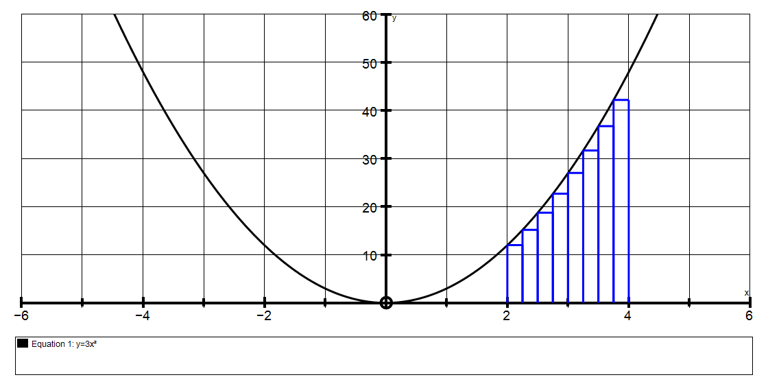
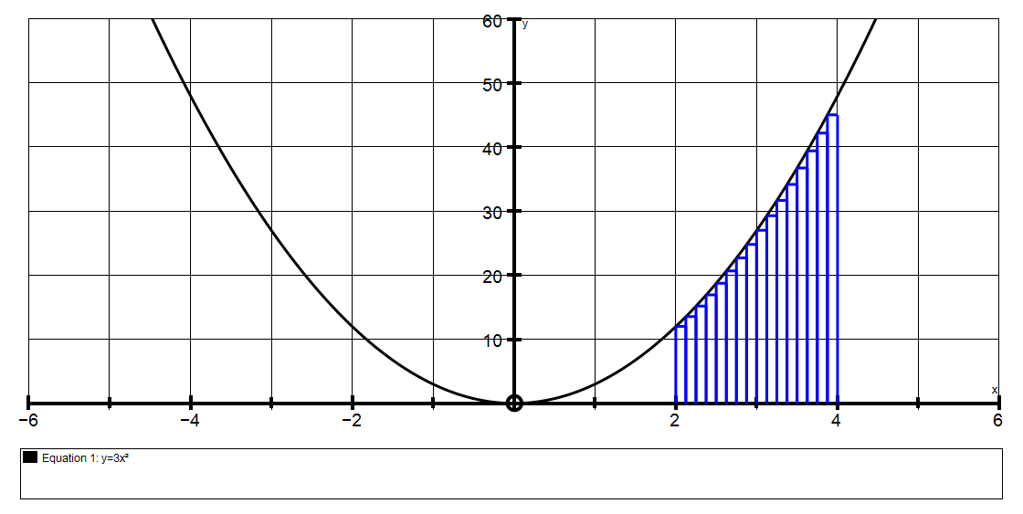
And, to get a better approximation, we could split it into more and more rectangles
With 8 rectangles,
the area ≈ 51.56 units²
With 16 rectangles,
the area ≈ 53.77 units²
When we have n rectangles of width h, the algebra gets very, very complicated, but we could find what limit the expression approaches.
then see what this approaches (using limits).

Slide 4
For 4 rectangles the area = 48.96
For 8 rectangles the area = 51.56
For 16 rectangles the area = 53.77
For 50 rectangles the area = 55.28
For 100 rectangles the area = 55.64
For 500 rectangles the area = 55.93
For 1000 rectangles the area = 55.99

Slide 5
Generally, this is what we could do:
Area of 1 rectangle ≈ f(x) × h
f(x)
h
Area of all the rectangles ≈ ∑ f(x)× h
Actual area under the curve = lim ∑ f(x)×h
^{h→0}
which is written as ∫ f(x) dx
( but evaluating this limit is incredibly complicated)

Slide 6
After an lot of algebra, it would probably come to an expression similar to this:
Area = lim 56( 1 + 2h + 4h² + 8h³ + … )
^{as h→0}
= 56 units²
Unfortunately, simplyfying the expression into something like the above is extremely difficult. (see pages 285 – 288 in my book)

Slide 7
However, consider this approach:
Suppose there exists a formula or expression, in terms of x, to find the area under a curve.
We will call this formula or function A(x).
Similarly, we could find the area of a circle by splitting it into rectangles the same way.
But we already know there is a formula to find the area of a circle A = πr².
We are looking for a similar “formula” for areas under curves.

Slide 8
It is most helpful to think of this in the following way:
A(x₁) = area under the curve from x = 0 to x = x₁
A(x₁)
0 x₁
A(x₂) = area under the curve from x = 0 to x = x₂
A(x₂)
0 x₂
So the area from x₁ to x₂ could be written as A(x₂) – A(x₁)

Slide 9
Now consider just one of the “rectangular” strips mentioned earlier
(greatly enlarged for clarity) F E
The area of the strip could be written as : D C
A(x+h) – A(x)
Where A(x+h) means the area from 0 to x+h
MINUS
A(x) which means the area from 0 to x
The area of the strip is between the areas of the
two rectangles ABCD and ABEF
area ABCD < A(x+h) – A(x) < area ABEF
f(x)×h < A(x+h) – A(x) < f(x+h)×h
f(x)
f(x+h)
h
A
B

Slide 10
Dividing throughout by h, we get:
f(x) < A(x+h) – A(x) < f(x+h)
h
If we find the limit of this as h 0,
the three quantities become equal because
the two outer quantities both become f(x).
lim f(x) < lim A(x+h) – A(x) < lim f(x+h)
h→0 h→0 h ^{h→0}
which leaves us with f(x) < dA < f(x)
dx
so obviously dA = f(x)
dx

Slide 11
Consider the meaning of : dA = f(x)
dx
In words, this says,
“ If we DIFFERENTIATE the expression for the AREA
we get the EQUATION of the curve.”
Or in other words,
“The formula for AREA is
the ANTIDERIVATIVE of the equation of the curve.”
Briefly: INTEGRATION is ANTIDIFFERENTIATION!

Slide 12
GENERALLY: y y = f(x)
area A
a b x
_{b} Area A = ∫ f(x) dx which means:
ª
Find the antiderivative of f(x) = A(x)
then calculate A(b) – A(a)

Slide 13
eg if y = f(x) = 3x² and a = 2 and b = 4
₄
then Area A = ∫ 3x² dx
²
4
= x³
2
= 4³ – 2³
= 64 – 8
= 56 units²
A

